Slide 1
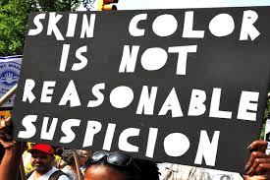
Racial Bias
By: Andre, Andrea, & Ansumana

Slide 2
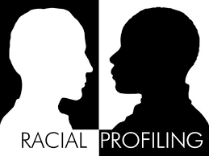
Topic
Black people are more likely to be pulled over by the police, for any reason, than white people.

Slide 3
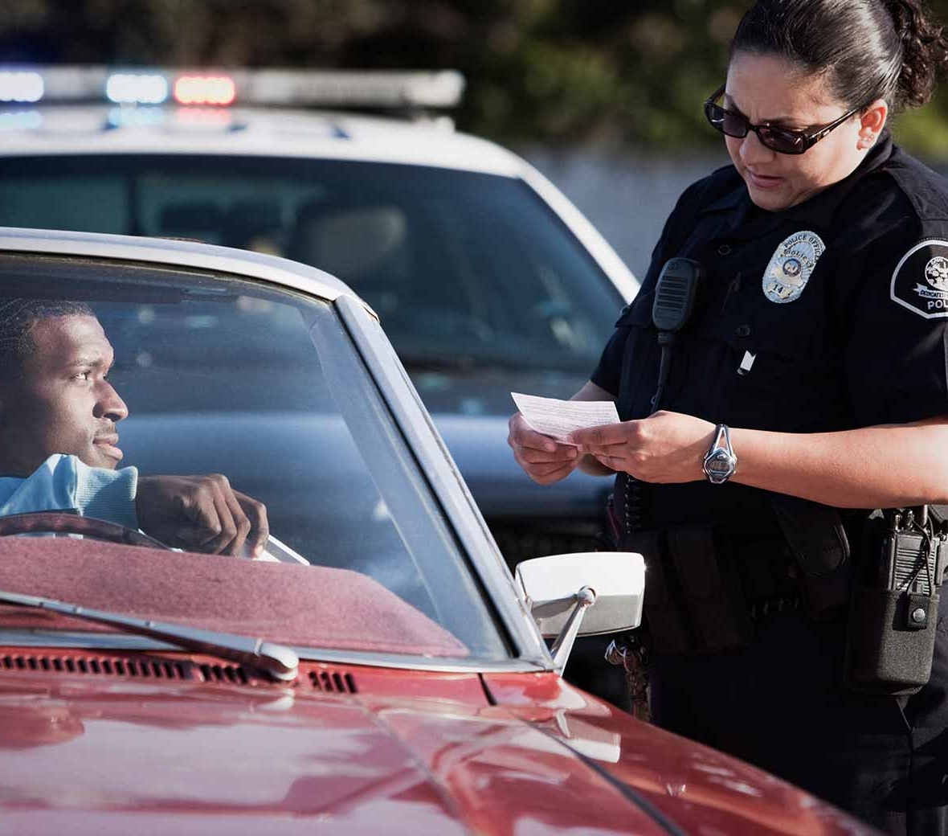
Intro
Studies reveal that Black people are more likely to be pulled over by police officers, Even after controlling for characteristics such as driving conduct and location. For example, a 2019 research by the Stanford Open Policing Project discovered that black drivers are stopped more frequently than white drivers across the United States, regardless of the severity of the traffic violation. Furthermore, data from the Bureau of Justice Statistics show that Black people are more likely to be searched and arrested during police confrontations. These disparities have spurred continuing arguments about systematic racism in law enforcement and the need for reform to promote equitable treatment of all individuals.

Slide 4
Tv show example
https://youtu.be/O-31Al7ZFL8?si=XVOrgIjseIRpvhBJ
In 9-1-1 (FOX), Michael Grant is pulled over by police while driving home with his daughter and son. When he questions the stop, the officer cites expired tags and ignores Michael’s attempt to explain that he has the tags in the car. The situation escalates as the officer aggressively slams Michael onto the car. His daughter starts recording, but the officer tries to take her phone. Meanwhile, when Michael’s son sits up in the back seat, an officer pulls a gun on him, intensifying the tense and traumatic encounter.
The audience reach are people who have experienced racial profiling or bias.

Slide 5
The Impact of Racial Profiling: Stereotypes, and Systemic Inequality
How does this reinforce stereotypes or biases?
This situation reinforce stereotypes that Black people are more likely to be perceived as threats or troublemakers. The officer's hostile and dismissive demeanor toward Michael, despite his attempts to comply, demonstrates a bias that implies Black individuals are more suspicious or dangerous. The use of excessive force, even in the presence of children, reinforces the notion that Black people are naturally aggressive or violent.
What are the potential consequences for public perception or societal behavior?
This type of portrayal can influence public opinion by promoting unfavorable stereotypes about Black people and law enforcement. For the general public, it may spread the belief that Black people should be treated with distrust, even in everyday situations. It may also cause heightened fear and suspicion of police officers in Black neighborhoods, eroding collaboration with law enforcement and escalating tensions between officers and civilians.

Slide 6
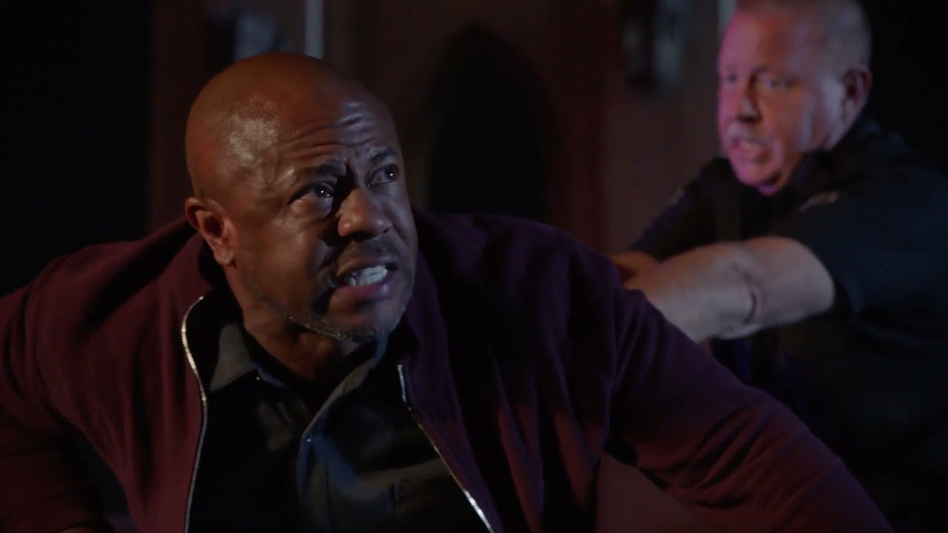
systemic inequality
How does this example contribute to systemic inequality?
This encounter demonstrates how racial bias in policing contributes to structural inequality by highlighting how Black people are particularly targeted and subjected to harsh treatment. The officer's contempt for Michael's explanation, as well as his excessive use of force, show institutional norms that continue to perpetuate discrimination in law enforcement. Over time, such episodes perpetuate unequal power dynamics and impede progress toward fairer, more egalitarian policing.

Slide 7
Example of the chosen Bias
A man named Rossano V. Gerald was pulled over by police multiple times when he crossed the Oklahoma border, as stated by (Harris, 1999) .
Nothing Rassano did warrented a traffic stop in either instance and he was treated very poorly during the second stop particularly.

Slide 8
Research and Contextualize
Some studies have been made detailing more examples of the issue in question.
Historically, this has been an issue as seen back in the 90's with Rossano.
Another example comes from a study led by Stanford University , (Willingham, 2019) states it was found that black motorists were 20% more likely to be pulled over than white motorists.
This example again shows that this stereotype is not unrealistic by any means.

Slide 9
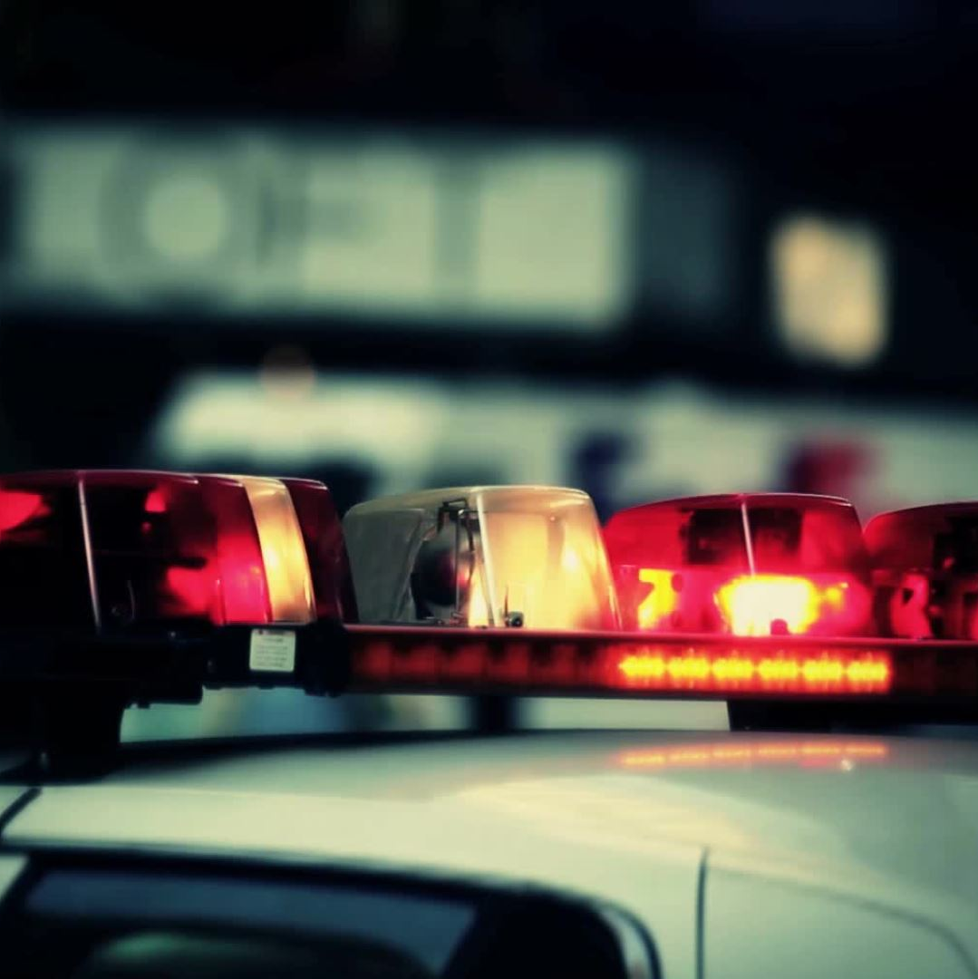
Hypothesis
Black people are more likely to be pulled over by the police, for any reason, than white people.

Slide 10
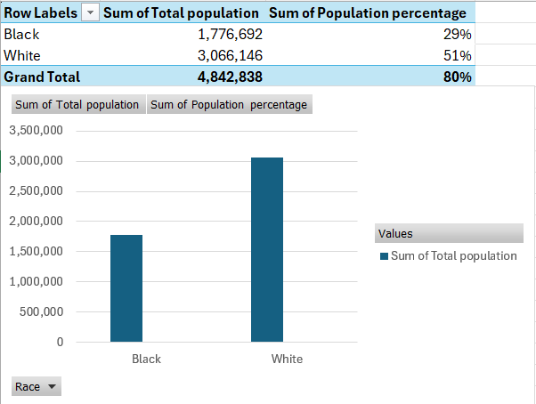
Data gathered to prove Hypothesis
Data sourced from the Maryland Healthcare Commission and the Governor’s Office of Crime Prevention and Policy

Slide 11
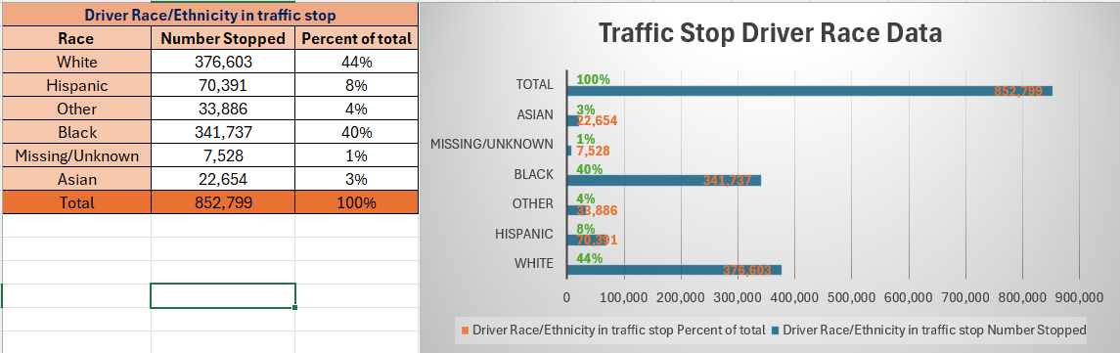

Slide 12
Future Projects
In terms of future work, we would likely analyze data from more US states.

Slide 13
Insights from the semester
What did you learn from the course?
What did you like the most about the course, if anything?
What did you like the least about the course, if anything?

Slide 14
References/Citations
Harris, D. A. (1999, June 7). Driving while black: Racial profiling on our nation’s Highways. American Civil Liberties Union. https://www.aclu.org/publications/driving-while-black-racial-profiling-our-nations-highways
Willingham, A. (2019, March 21). Researchers studied nearly 100 million traffic stops and found black motorists are more likely to be pulled over. CNN. https://www.cnn.com/2019/03/21/us/police-stops-race-stanford-study-trnd/index.html
https://journalism.stanford.edu/news/stanford-open-policing-project-analyzed-data-nearly-100-million-traffic-stops-us#:~:text=A%20study%20of%20nearly%20100,rates%20before%20and%20after%20sunset.

Slide 15
References/Citations
Pierson, E., Simoiu, C., Overgoor, J., Corbett-Davies, S., Jenson, D., Shoemaker, A., Ramachandran, V., Barghouty, P., Phillips, C., Shroff, R., & Goel, S. (2020). A large-scale analysis of racial disparities in police stops across the United States. Nature Human Behaviour, 4(7), 736–745. https://doi.org/10.1038/s41562-020-0858-1
Larry Hogan. (2019, September 19). Race-Based Traffic Stop Data Analysis (Fifteenth Report to the State of Maryland) & Race-Based Traffic Stop Data Dashboard . Maryland. https://gocpp.maryland.gov/wp-content/uploads/traffic-stop-report-2018.pdf

Slide 16
References/Citations
Dorothy Lennig. (2024, September 5). Traffic stop data reporting. Governor’s Office of Crime Prevention and Policy. https://gocpp.maryland.gov/crime-statistics/law-enforcement-reports/traffic-stop-data/
Maryland Healthcare Commission . (2017). Overall Population. Maryland Healthcare Commission . https://mhcc.maryland.gov/mhcc/pages/hcfs/hcfs_con/documents/Filed_2021/Doctors_2448/con_drs_2448_exhibit28.pdf
9-1-1 - Michael’s Traffic Stop. (2024). Youtu.be. https://www.youtube.com/watch?v=O-31Al7ZFL8

